Slide 1
Book-King
Professional Practice in IT 3rd Year Project
Arron Healy G00346883
Mark Gilmore G00214777

Slide 2
Introduction
Book-King is a website that allows users to buy and sell books as well as create and comment on threads about books
It is created using the MERN stack (MongoDB, Express, React, NodeJS) and Redux

Slide 3
The idea
After our first meeting we decided that we would build a market place that allowed users to buy and sell their books online. This idea of course is very common online so we decided to not only make a market place but make it a social media like hub for like minded book enthusiasts.
After careful consideration we decided to build it using the MERN stack and Redux.

Slide 4
Aims and objectives
To build a social media like website that allowed like minded people buy, sell and converse about books
Learn new technologies no included in the course (React, Redux)
Gain a better understanding of version control
Learn to work as a team on big projects

Slide 5
Architecture
We used the MERN stack to build the project.
MERN stack is a free, open source JavaScript software stack for building dynamic websites and web applications
The MERN stack is made up of the following components:
MongoDB
Express
React
NodeJS

Slide 6
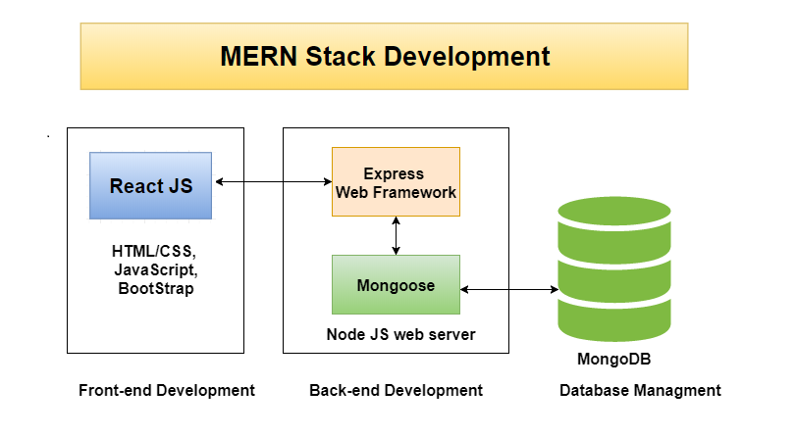

Slide 7
Why mern stack
In our 1st semester of 3rd year we used the MEAN stack and wanted to learn something new that was not part of our course.
After considering similar libraries to the MEAN stack (MERN, VUE) we decided to use the MERN stack
Maintained by Facebook and seemed the more popular of the two

Slide 8
React Features
JavaScript library which lets you build user interfaces for web applications
The most important concept to understand in ReactJS is the component
Maintained by Facebook and is currently one of the most popular in the world
Can be a function component or a class component

Slide 9


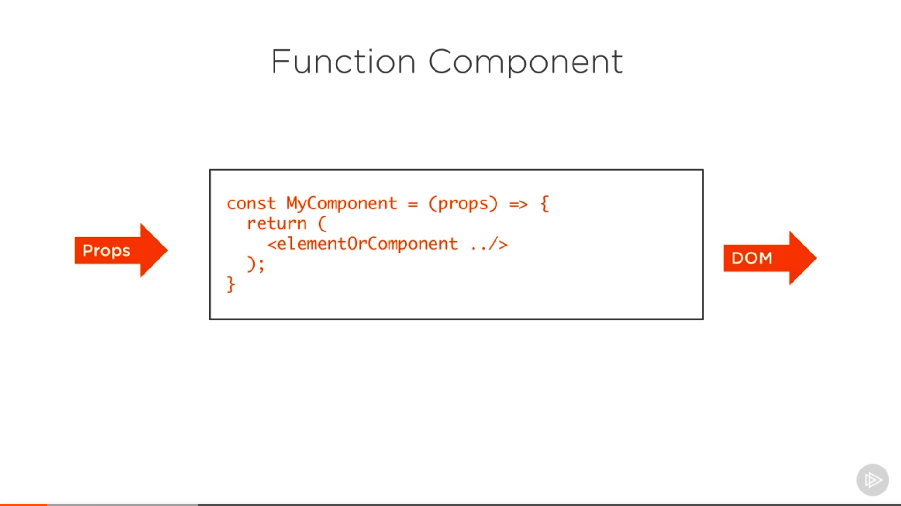
Function component
A function component is the simplest form of a React component. It is a simple function with a simple contract. The function component receives an object of properties which is usually named props. It returns what looks like HTML, but is really a special JavaScript syntax called JSX

Slide 10
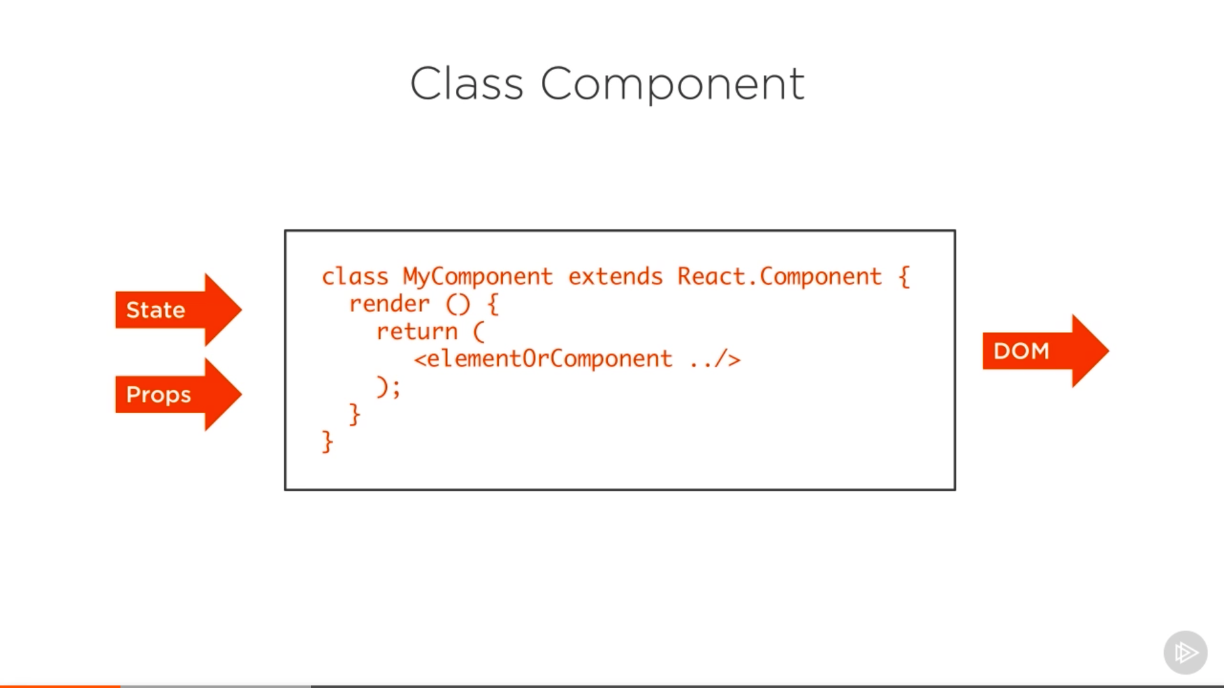
Class component
A class component is a more featured way to define a React component. It also acts like a function that receives props, but that function also considers a private internal state as additional input that controls the returned JSX

Slide 11
Jsx
JSX is an XML/HTML-like syntax used by React that extends ECMAScript so that XML/HTML-like text can co-exist with JavaScript/React code.
The syntax is intended to be used by preprocessors to transform HTML-like text found in JavaScript files into standard JavaScript objects that a JavaScript engine will parse

Slide 12
Redux
An open-source JavaScript library for managing an applications state
Central data store for all your apps data
Can be accessed by any component by dispatching action (addPost etc.)
Reducer updates the central state

Slide 13
Libraries used
Axios (Allows you to make HTTP requests from node.js)
Classnames (javascript utility for conditionally joining class names together)
Formdata (Interface provides a way to easily construct a set of key/value pairs representing form fields and their values)
Jwt-decode (Used to generate auth tokens)
Multer (Middleware for uploading files or images)
Bcryptjs (Used for hashing passwords)
Body-parser (Allows access to req.body from within your routes)
Concurrently (Allows the running of multiple commands)
Passport (Lets you authenticate endpoints using a JSON web token

Slide 14
Timetable
Weeks 1-2: Get to grips with React and Redux by doing several YouTube tutorials and initial project skeleton setup
Weeks 3-4: Login and Register. Arron (Backend), Mark (Frontend)
Weeks 4-5: Profile (Add, Delete etc.), Dashboard, Book (List, Add, Delete etc.)
Weeks 6-7: Arron (Post, Post feed etc.), Mark (Shopping Cart)
Weeks 8-9: Book and Profile Image, Search Bar
Weeks 10: README, Tidy Code, Heroku Setup

Slide 15
Problems encountered
Learning new technologies in a short space of time
Learning to work together on a team project for the first time
Learning to constantly update GitHub

Slide 16
Conclusions
Overall building the project was a very enjoyable experience. As well as learning new technologies we developed our communication skills, our ability to work as a team, a better understanding of version control and most importantly we gained valuable knowledge of what it is expected in the industry. We overcame any obstacles by working together and learned that it is better to have two people working together than trying to do things on our own.

